Slide 1



[HITT, HANKINSON, ANDERSEN, D’SOUZA – RADAR]
GROUP 32

Slide 2




MEET THE TEAM
SHANNON HANKINSON
ELECTRICAL ENGINEERING
BAILEY HITT
ELECTRICAL ENGINEERING
RYAN ANDERSEN
ELECTRICAL ENGINEERING
JOSHUA D’SOUZA
COMPUTER ENGINEERING

Slide 3

PROBLEM STATEMENT
2HAD-RAD is a battery-powered handheld device that enhances search and rescue operations in low-visibility indoor and outdoor environments.
It fuses a 24 GHz and a 60 GHz radar, barometric temperature compensation for improved IR thermal imaging, and a UWB + INS stack for precise localization. The system detects human breathing, body heat, and movement, generating high-confidence detections and 3D location estimates. Visual and auditory alerts trigger when detection thresholds are met, with all data logged in a companion mobile application for actionable intelligence.

Slide 4

GOALS & OBJECTIVES
Basic Goals
  UWB ranging will be integrated to provide approximate distance measurements that extend INS functionality in indoor, GPS denied environments.
  Provide relative location and orientation tracking using an INS with barometric feedback.
  Confirm human presence by detecting body heat signatures using an IR sensor.
  Display detection results on an LCD interface providing immediate visual feedback.
  Entire device powered by rechargeable battery station
  Radar detects motion and respiration

Slide 5
GOALS & OBJECTIVES
Advanced Goals
  Maintain performance in smoke-filled or low-light environments
  Improve relative location tracking precision by using GNSS.
  Optimize the power delivery for extended operational runtime.
  Enhance LCD readability with clear formatting and detection indicators.
  Data is transmitted from device to android application through BLE
Stretch Goals
  Machine learning layer which improves classification accuracy
  Radar detection through building materials
  Improve the thermal array visualization to produce a clearer, more stable thermal map on the UI.
  Enhance data transmission to the Android application in real-time and include positional mapping.
  Battery monitor on LCD displaying voltage, charge %, estimated runtime

Slide 6
GOALS & OBJECTIVES
Basic Objectives
  IR confirms human presence in line-of-sight conditions within ≤ 1 meter.
  INS and barometer sense relative location within ≤ 2 meters.
  Display detection feedback on LCD within 5 seconds of confirmed detection.
  A red LED indicates when a human is detected in less than 1 second.
  Buttons to mark the location of a victim, clear/reset, power the device and navigate the LCD screen.
  Operate the complete device on a rechargeable subsystem for ≥ 2 hours of continuous use.
  Radar detects human distance and respiration within ≤ 2 meters

Slide 7
GOALS & OBJECTIVES
Advanced Objectives
  Demonstrate consistent radar detection in cluttered or noisy environments with ≥ 90% detection accuracy.
  Demonstrate radar-based detection of a human subject within a line-of-sight range of at least 2 meters.
  Improve fused localization accuracy within ≤ 4 meter when GNSS data is fused with INS outdoors.
  Enhance LCD readability in field conditions to ≥ 90% legibility under ambient light with clear indicator labels.
  Transmit data from the handheld device to an android mobile application through BLE within 5 seconds.
  Improve operational runtime by at least 25% compared to baseline while maintaining ≤ 10 W power draw.

Slide 8
GOALS & OBJECTIVES
Stretch Objectives
  Demonstrate detection of human presence through 1 inch of drywall material in controlled indoor tests with ≥ 80% accuracy.
  Incorporate a hazard awareness layer that flags 3 potential risks using fused sensor data with ≥ 80% detection accuracy
  Add user adjustable controls to UI, add detection modes, heat map visualization and update display within 5 seconds of adjustment.
  Add real-time battery monitoring to charge percentage and estimated runtime on the UI.
  Enhance android application with real-time positional mapping with ≤ 2 second latency.

Slide 9
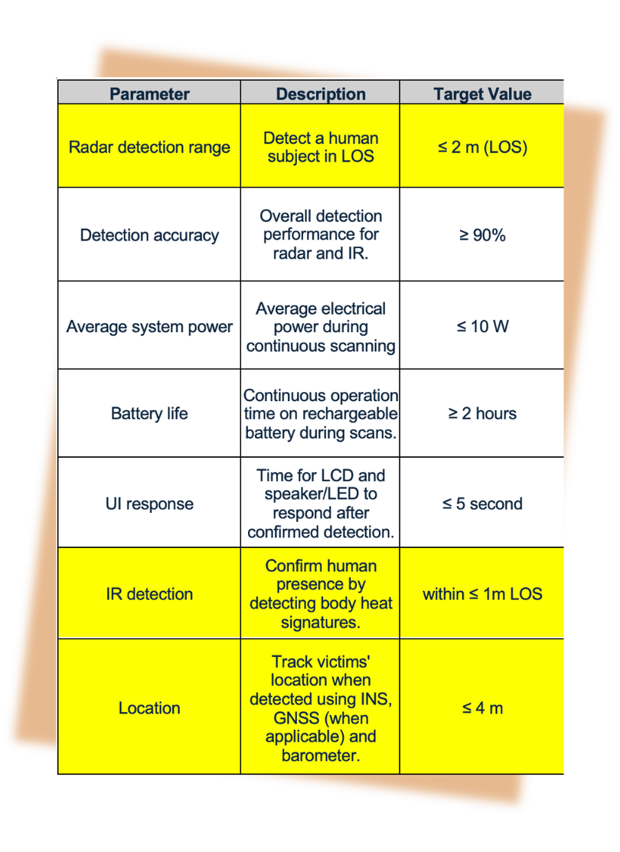
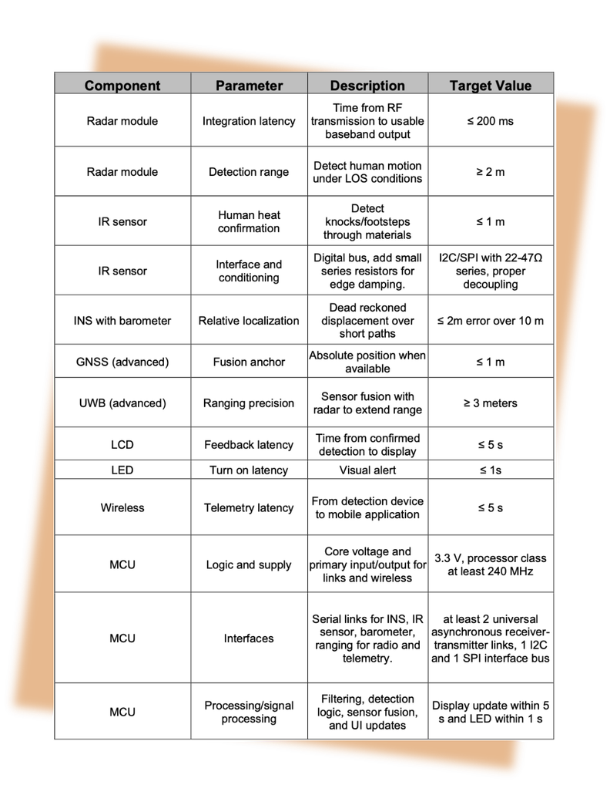
ENGINEERING SPECIFICATIONS

Slide 10
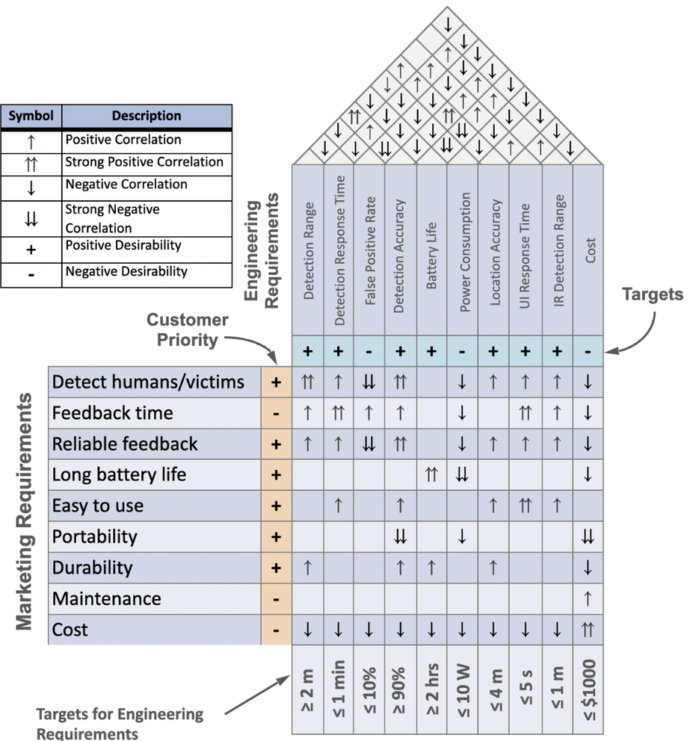
HOUSE OF QUALITY

Slide 11
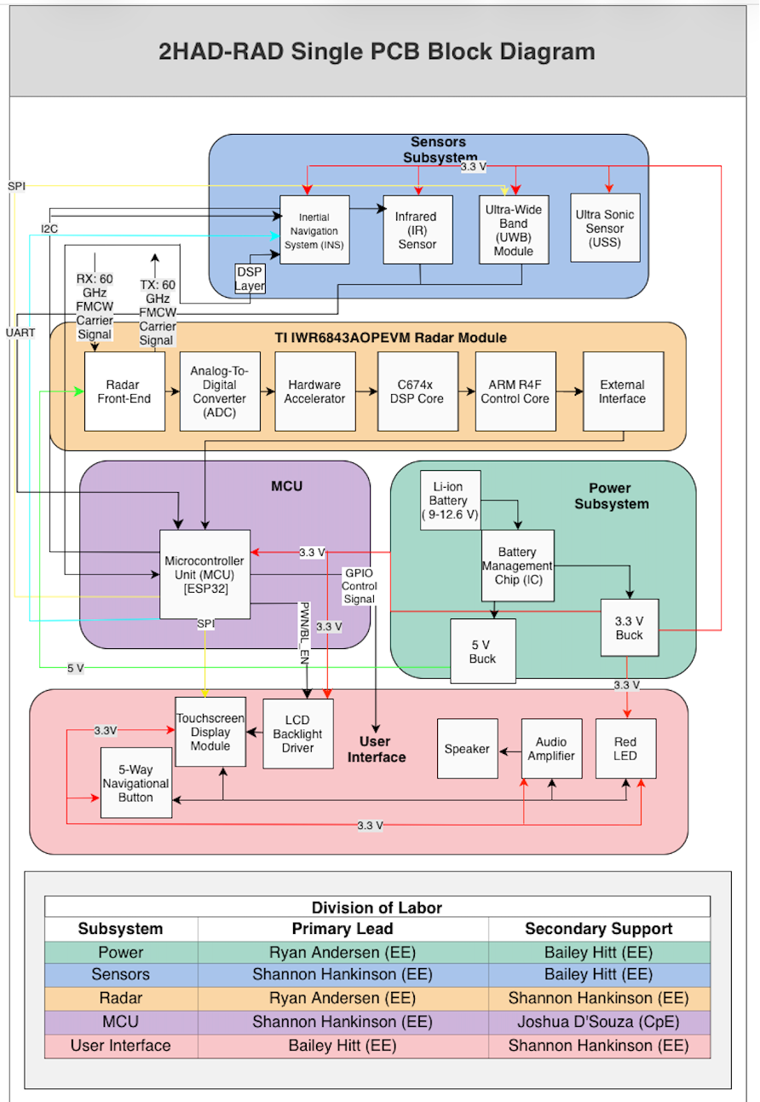
HARDWARE BLOCK DIAGRAM

Slide 12
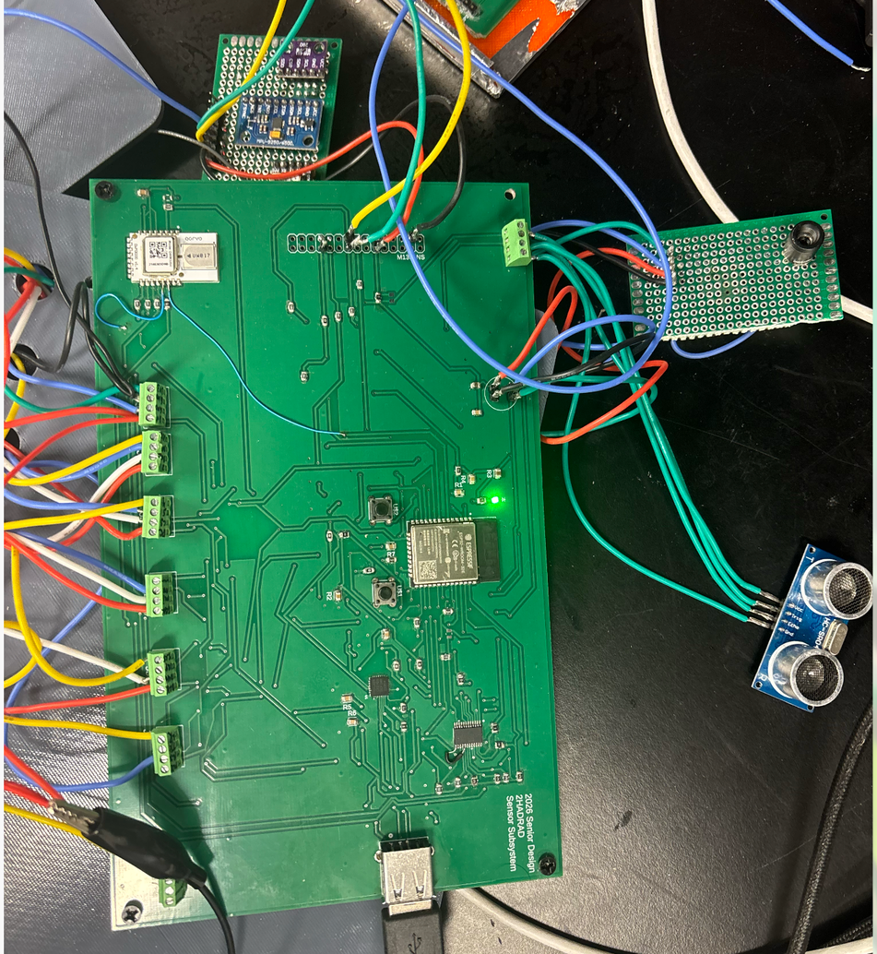
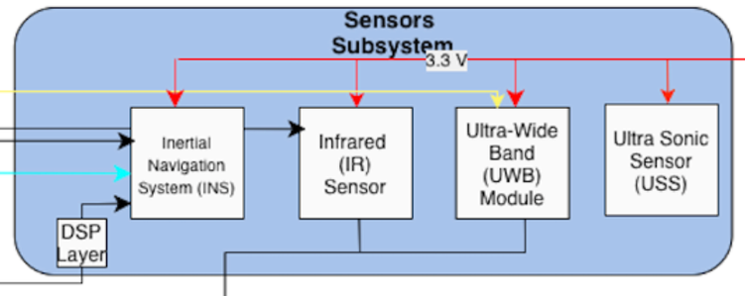
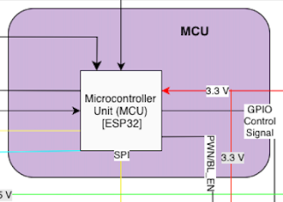
SENSOR SUBSYSTEM AND MCU
INS - UART and I2C
IR - I2C
UWB - SPI
USS - GPIO
MCU

Slide 13
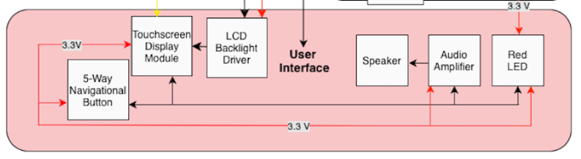
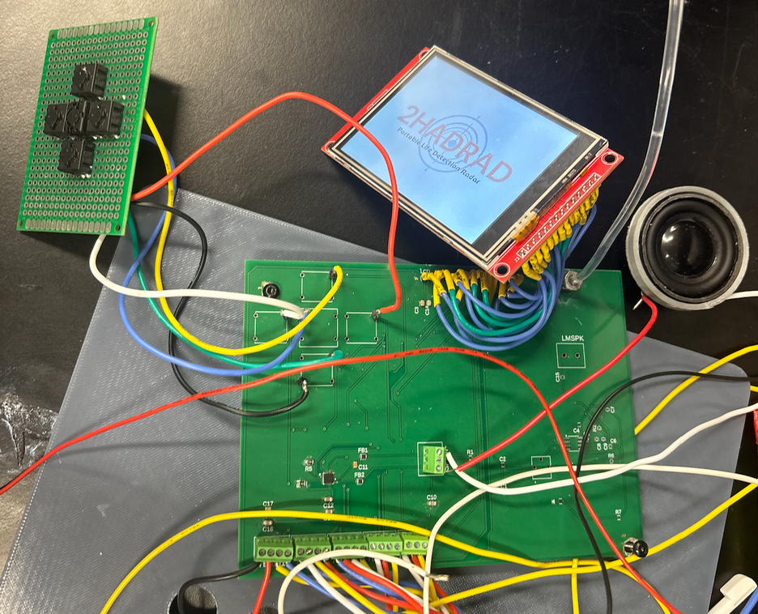
USER INTERFACE
Button - GPIO
LCD - SPI
Light pipe
Speaker
LED - GPIO
AMP - I2S

Slide 14
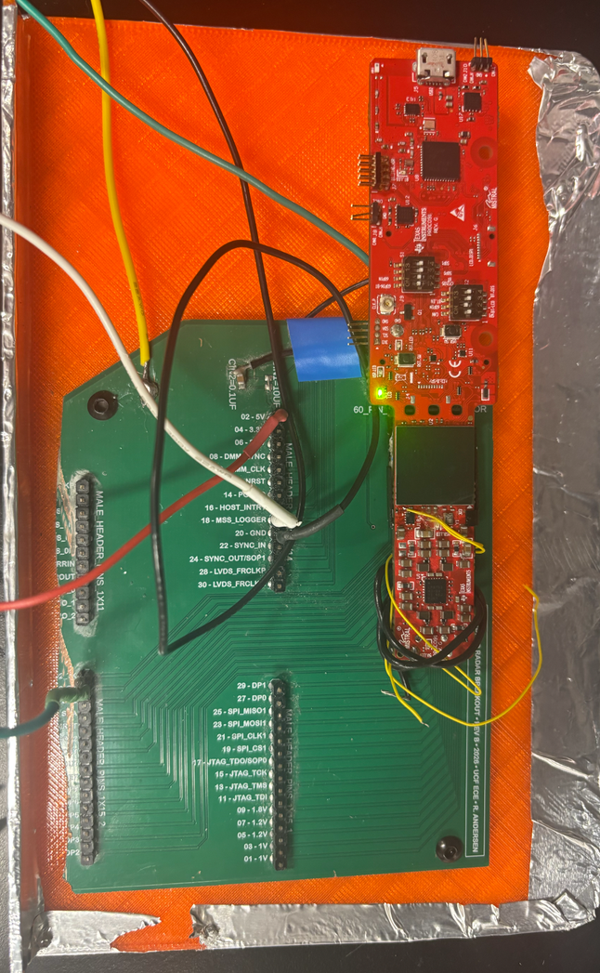
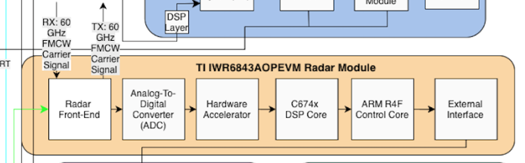
60 GHZ RADAR MODULE
Radar - UART
Antenna-on-Package
SOC

Slide 15
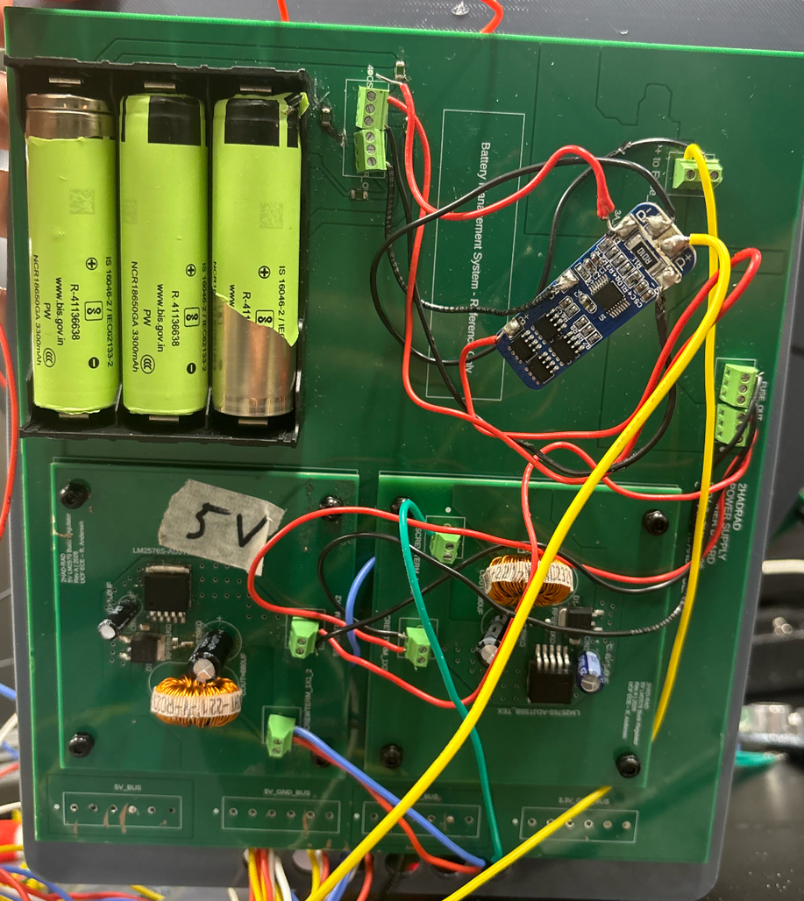
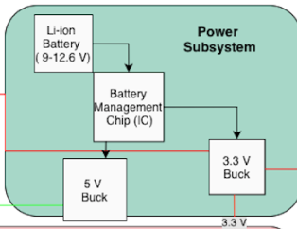
POWER SUBSYSTEM
Battery Management
5V Buck
3V Buck

Slide 16
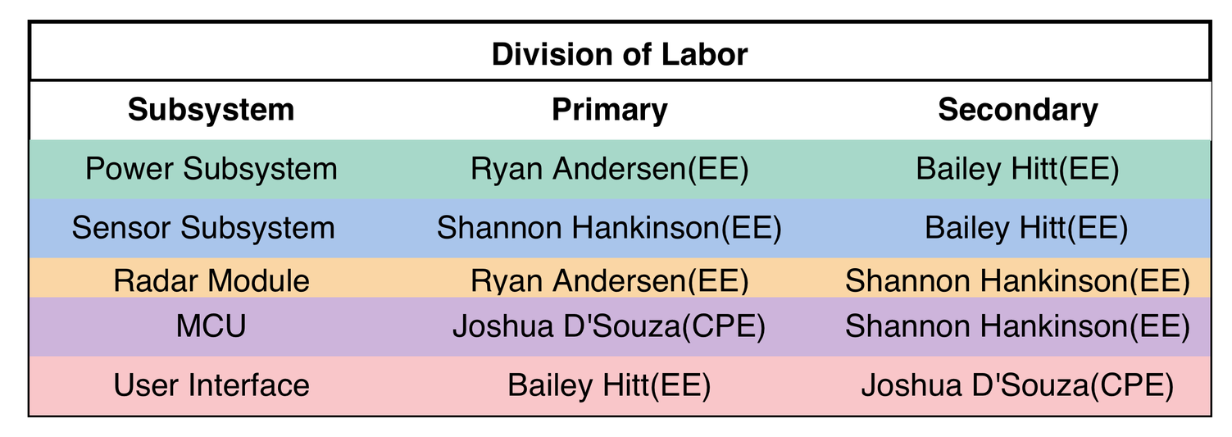
DIVISION OF RESPONSIBILITY

Slide 17
PERIPHERALS
Audio System
Amplifier & Speaker
Heat Detection
Infrared Sensor
Location Tracking
Ultra Wide Band Sensor (UWB)
Safety
Ultra Sonic Sensor
User Interface
LCD Screen

Slide 18
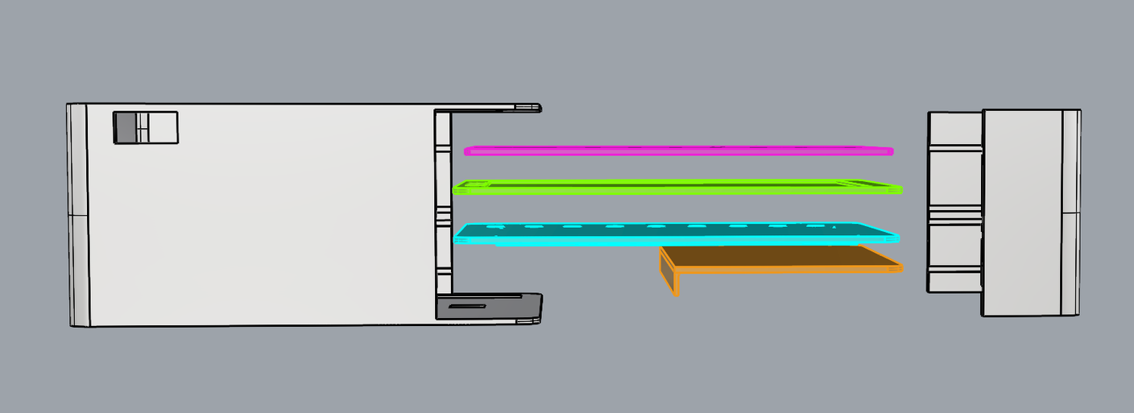
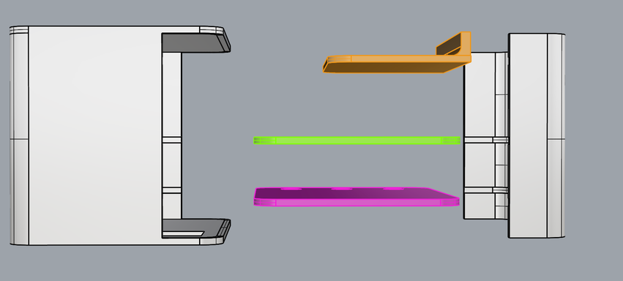
SYSTEM ENCLOSURE
UI
Power
Sensor Subsystem
Radar
  Stacked architecture separates UI, power and sensor subsystems to improve organization and serviceability.
  Dedicated PCB mounting plates provide mechanical stability and allow structured board spacing within the enclosure.
  Integrated cable routing pathway minimizes signal coupling and mechanical interference between sensitive RF/sensor lines.
  Ventilated top panel enables passive thermal management while maintaining proper sensor sight and antenna performance.

Slide 19
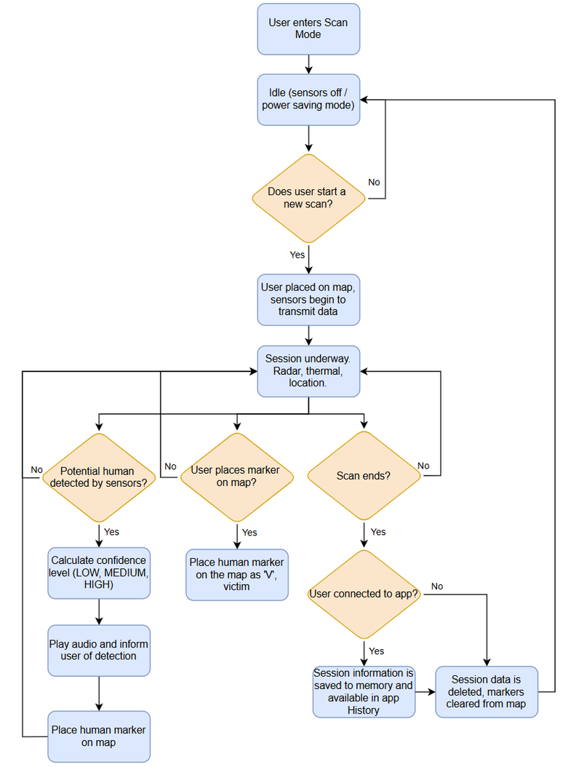
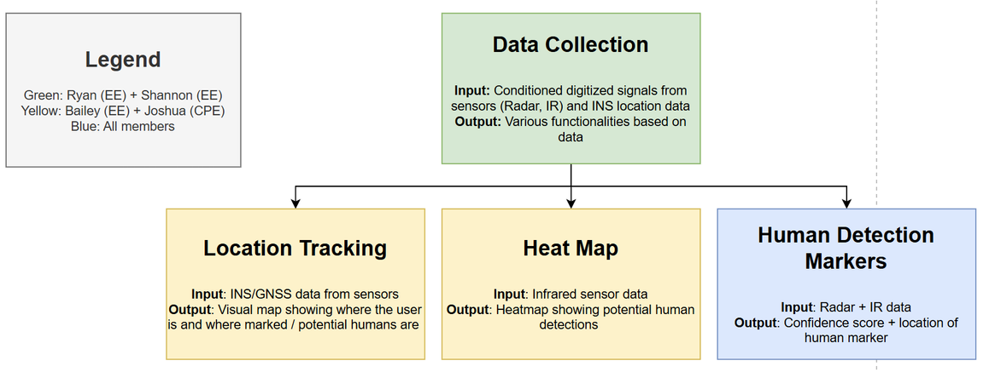
SOFTWARE DESIGN

Slide 20
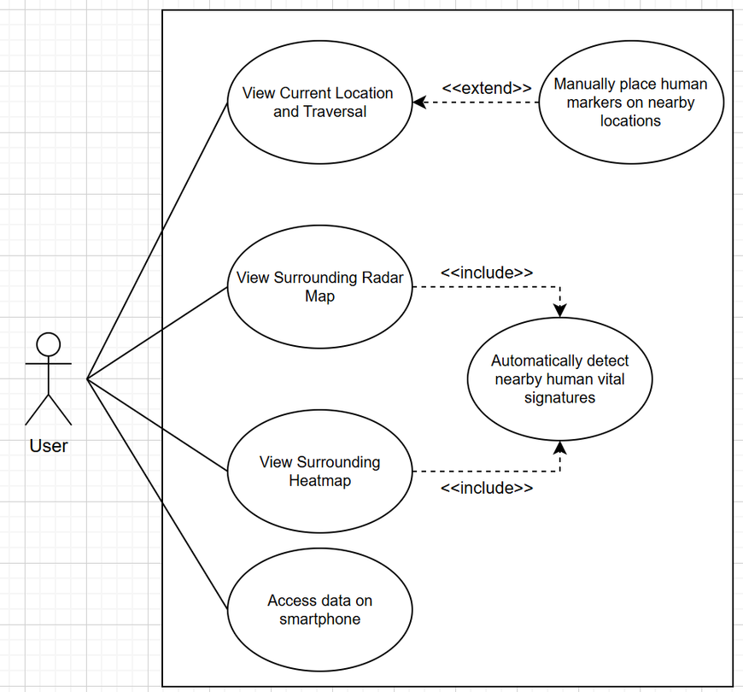
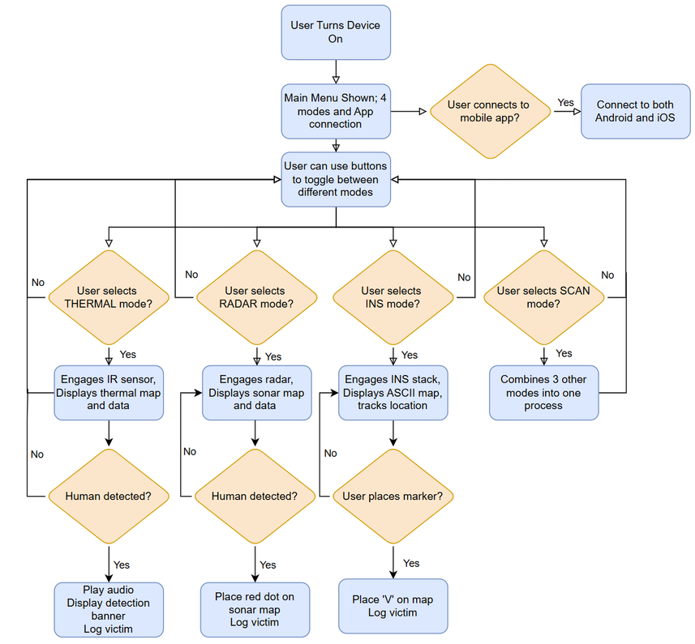
SOFTWARE DESIGN
USE CASE DIAGRAM
UI FLOWCHART

Slide 21
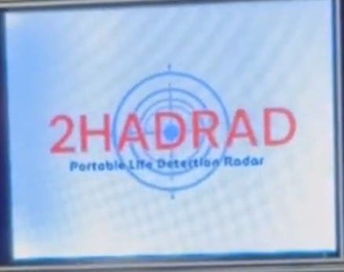
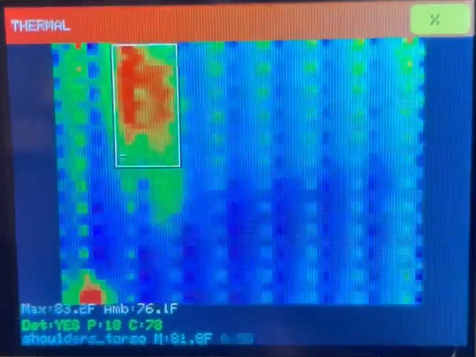
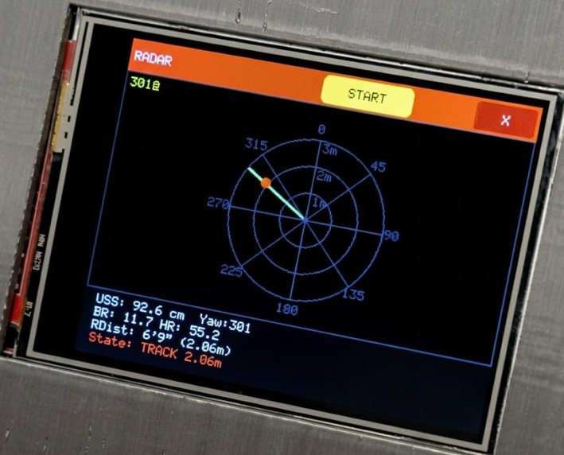
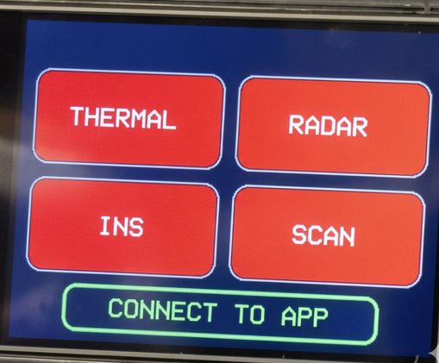
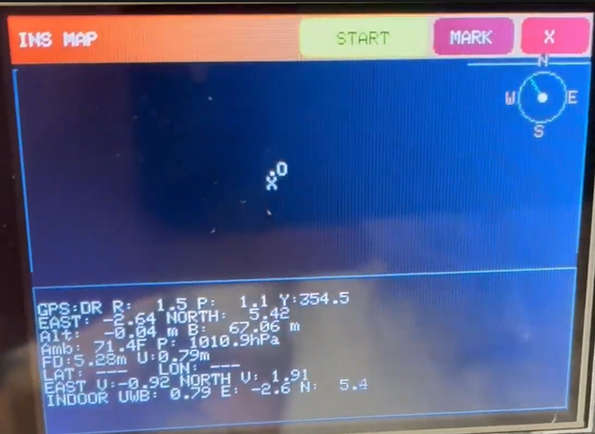
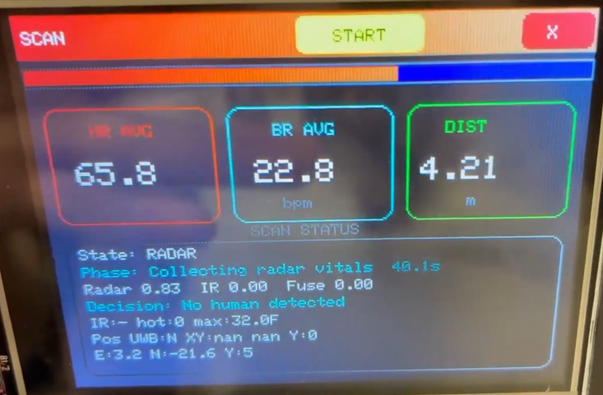
SOFTWARE DESIGN
SCREENSAVER
THERMAL MODE
RADAR MODE
MAIN MENU
INS MODE
SCAN MODE

Slide 22
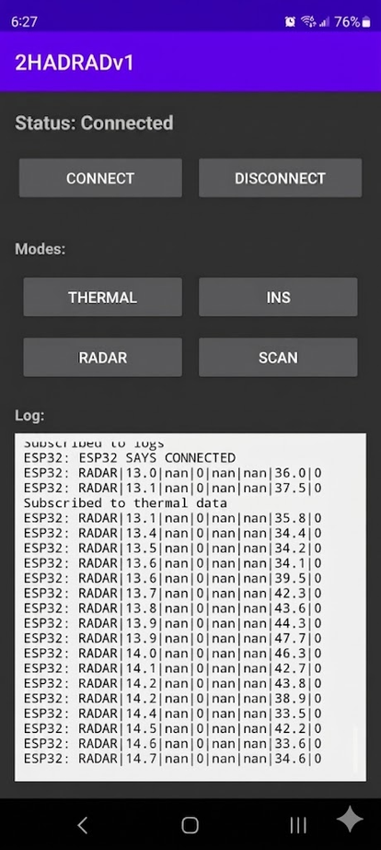
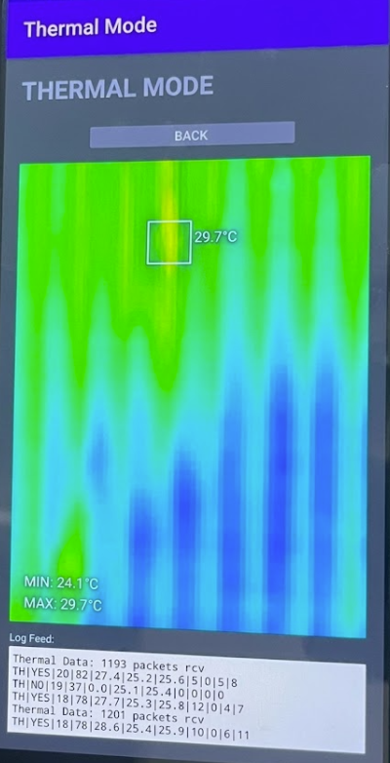
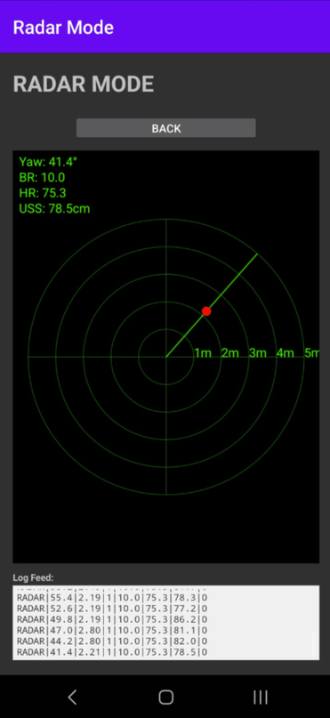
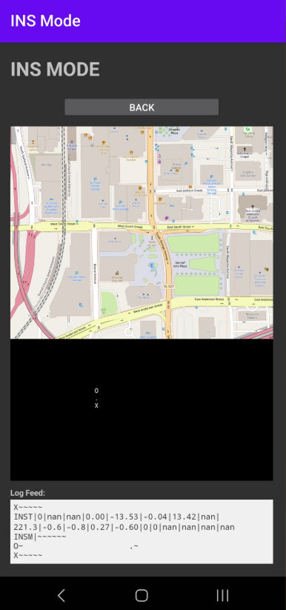
SOFTWARE DESIGN
SMARTPHONE APP UI
MAIN MENU

Slide 23
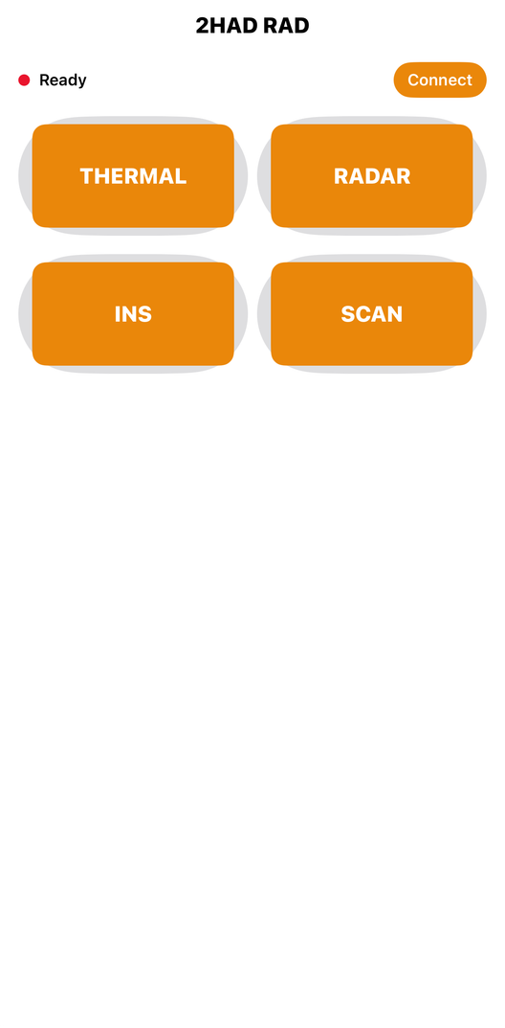
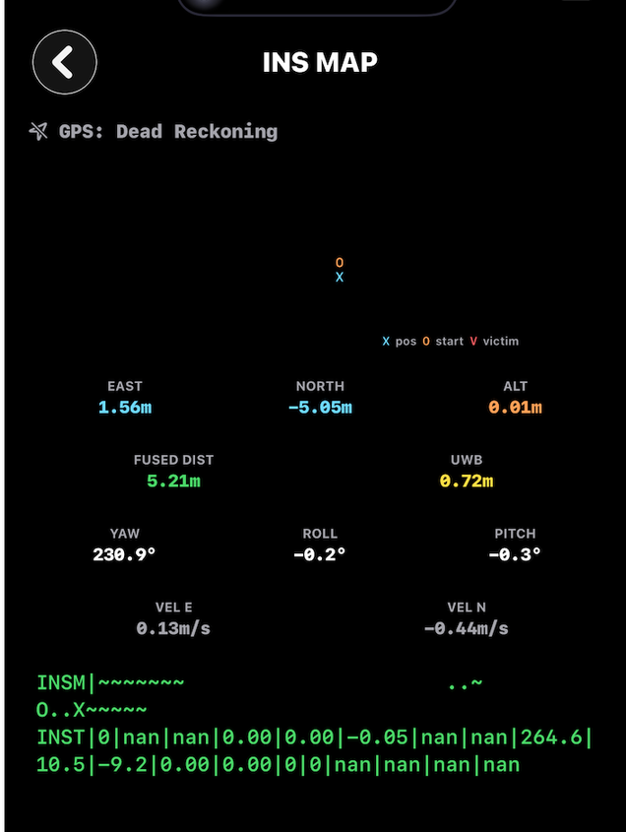
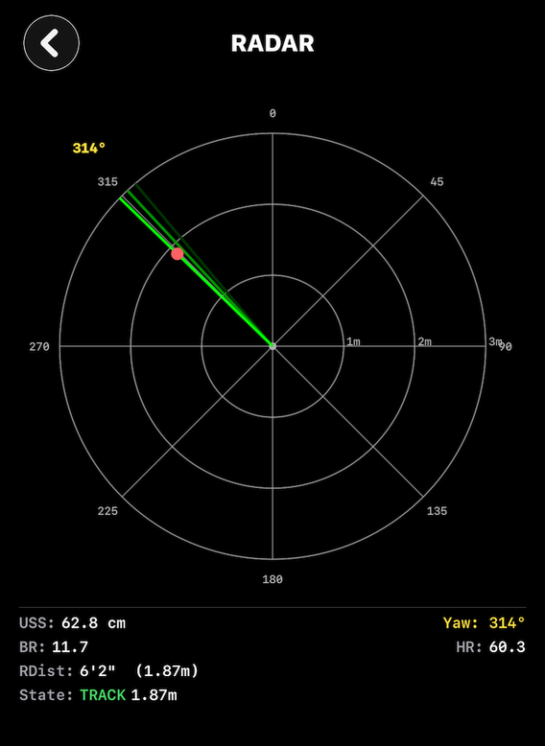
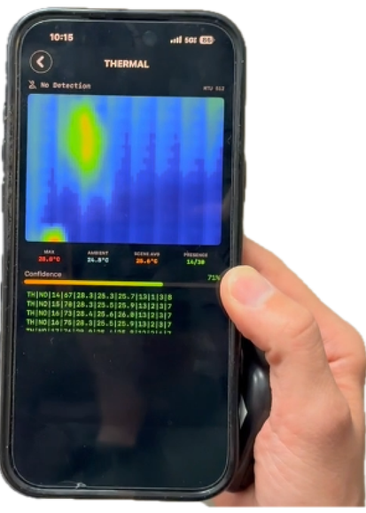
SOFTWARE DESIGN
SMARTPHONE IOS APP UI

Slide 24
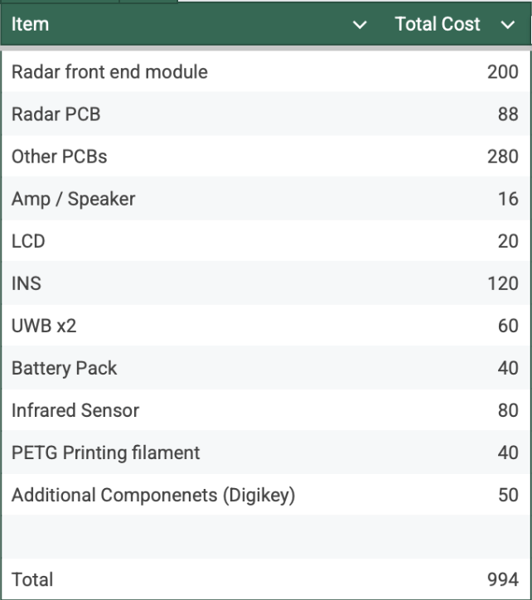
BUDGET

